Slide 1



COMPSCI 326
Lecture 03: JS Objects, Arrays, Functions, & Iteration

Slide 2
Resources
MDN Web Docs
JavaScript
JavaScript data types and data structures
Object
delete
in
Functions
Array
Array.prototype.length
Array.prototype.push
Array.prototype.pop
Array.prototype.shift
Array.prototype.unshift
Array.prototype.forEach
Array.prototype.map
JSON.stringify
JSON.parse
Truthy
Falsey

Slide 3
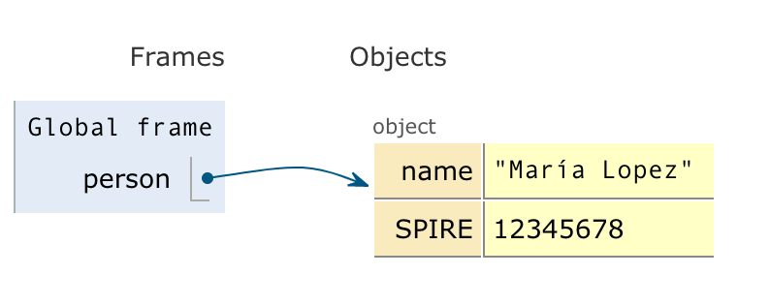
Objects - property access
We can access objects in two ways:
Like an array with brackets: person[‘name’]; ⇒ ‘María Lopez’ let id = ‘name’; person[id]; ⇒ ‘María Lopez’
Or like objects (similar to Java): person.name; ⇒ ‘María Lopez’
let person = { 'name' : 'María Lopez', 'SPIRE' : 12345678 };
Image from JavaScript Tutor - Visualize JavaScript code execution to learn JavaScript online - great place to try out snippets of JavaScript code!

Slide 4
Objects - property access
When to use brackets vs dots?
brackets
Use [] when you use a variable to access a property (like person[x])
When the property name contains characters that are not a valid identifier (person[‘favorite color’])
dots
When you know what the property is (e.g., person.name)
This is less verbose, more “JavaScripty”
Easier to catch your misspellings
let person = { 'name' : 'María Lopez', 'SPIRE' : 12345678 };
Image from JavaScript Tutor - Visualize JavaScript code execution to learn JavaScript online - great place to try out snippets of JavaScript code!

Slide 5
Objects - property existence
You can check if a property is in an object:
Using the in operator: ‘name’ in person; ⇒ true ‘age’ in person; ⇒ false
BEWARE: it is not an error if you try to access a property that doesn’t exist: person.age; ⇒ undefined person[‘age’] ⇒ undefined
let person = { 'name' : 'María Lopez', 'SPIRE' : 12345678 };
Image from JavaScript Tutor - Visualize JavaScript code execution to learn JavaScript online - great place to try out snippets of JavaScript code!

Slide 6
Objects - property deletion
You can delete a property from an object:
Using the delete operator: delete person.name; ⇒ true delete person[‘name’]; ⇒ true person; ⇒ {‘SPIRE’: 12345678}
BEWARE: it is not an error to delete a property that doesn’t exist: delete person.age; ⇒ true delete person[‘age’] ⇒ true
let person = { 'name' : 'María Lopez', 'SPIRE' : 12345678 };
Image from JavaScript Tutor - Visualize JavaScript code execution to learn JavaScript online - great place to try out snippets of JavaScript code!

Slide 7
Objects - to strings and back again
You can convert objects into strings and back
Using the JSON.stringify function: let str = JSON.stringify(person); str; ⇒ '{"name":"María Lopez","SPIRE":12345678}'
Using JSON.parse function: JSON.parse(str) ⇒ {name: 'María Lopez', SPIRE: 12345678}
let person = { 'name' : 'María Lopez', 'SPIRE' : 12345678 };
Image from JavaScript Tutor - Visualize JavaScript code execution to learn JavaScript online - great place to try out snippets of JavaScript code!

Slide 8
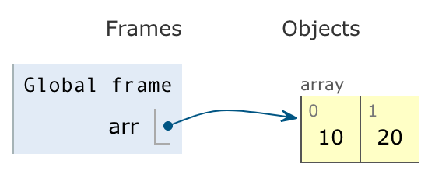
Arrays - length
You can get the length of an array
Using the length property: arr.length; ⇒ 2
BEWARE: if you misspell length you do not get what you expect: arr.lenth; ⇒ undefined
let arr = [10, 20];
Image from JavaScript Tutor - Visualize JavaScript code execution to learn JavaScript online - great place to try out snippets of JavaScript code!

Slide 9
Arrays - indexing
You can index arrays to retrieve elements:
Using the [] operators: arr[0]; ⇒ 10
Indexing an element that doesn’t exist: arr[12]; ⇒ undefined
let arr = [10, 20];
Image from JavaScript Tutor - Visualize JavaScript code execution to learn JavaScript online - great place to try out snippets of JavaScript code!

Slide 10
Arrays - truthy/falsy
!arr[12]; ⇒ true
Special values like undefined and null are “falsey”
They act like false, so when you negate them they are true
What about things that are not falsey?
if (‘huh’) console.log(‘Y’); ↦ ‘Y’ if (!’huh’) console.log(‘Y’); ⇒ undefined if ({}) console.log(‘Y’); ↦ ‘Y’ if ([]) console.log(‘Y’); ↦ ‘Y’ if (undefined) console.log(‘Y’); ⇒ undefined if (null) console.log(‘Y’); ⇒ undefined
let arr = [10, 20];
Image from JavaScript Tutor - Visualize JavaScript code execution to learn JavaScript online - great place to try out snippets of JavaScript code!

Slide 11
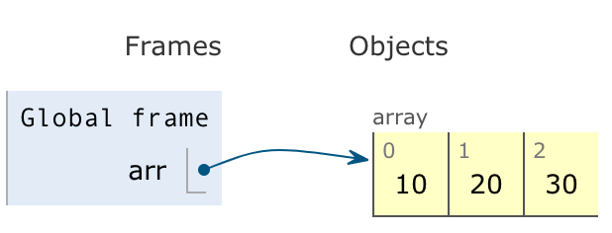
Arrays - like a stack, push/pop
You can treat arrays like a stack
Using the push method: arr.push(30); ⇒ 3 // new length arr; ⇒ [10, 20, 30]
Using the pop method: arr.pop(); ⇒ 30 // top value arr; ⇒ [10, 20]
let arr = [10, 20];
Image from JavaScript Tutor - Visualize JavaScript code execution to learn JavaScript online - great place to try out snippets of JavaScript code!

Slide 12
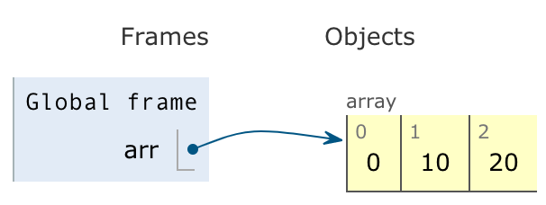
Arrays - from the front, shift/unshift
You can work from the front of the array
Using the unshift method: arr.unshift(0); ⇒ 3 // new length arr; ⇒ [0, 10, 20]
Using the shift method: arr.shift(); ⇒ 0 // front value arr; ⇒ [10, 20]
let arr = [10, 20];
Image from JavaScript Tutor - Visualize JavaScript code execution to learn JavaScript online - great place to try out snippets of JavaScript code!

Slide 13
Arrays - using it like a queue
To use an array like a queue (first-in, first-out / “FIFO”):
Use unshift to insert into the front: arr.unshift(0); ⇒ 3 // new length arr; ⇒ [0, 10, 20]
Use pop to remove from the back: arr.pop(); ⇒ 30 // front value arr; ⇒ [0, 10]
let arr = [10, 20];
Image from JavaScript Tutor - Visualize JavaScript code execution to learn JavaScript online - great place to try out snippets of JavaScript code!

Slide 14
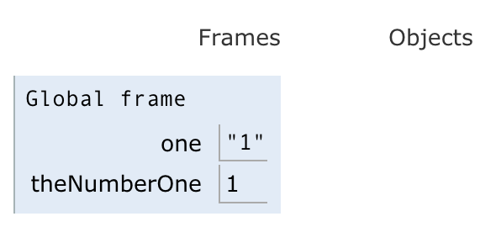
Arrays - to strings and back again
You can convert arrays to strings and back:
Use join to convert to a string: let str = arr.join(‘,’); str; ⇒ “10,20”
Use split to convert back to array: str.split(‘,’); ⇒ [‘10’, ‘20’]
To convert strings to numbers: let one = ‘1’; one + 1; ⇒ ‘11’ let theNumberOne = Number.parseInt(one); ⇒ 1 theNumberOne + theNumberOne; ⇒ 2 theNumberOne.toString(); ⇒ ‘1’
let arr = [10, 20];
Image from JavaScript Tutor - Visualize JavaScript code execution to learn JavaScript online - great place to try out snippets of JavaScript code!

Slide 15
Arrays - iteration
Many different ways:
Iterating with indices (not JavaScripty): for (let i = 0; i<arr.length; ++i) { console.log(arr[i]); }
You can use shift (destroying array): while (arr.length > 0) { console.log(arr.shift()); }
You can iterate with let … of: for (let item of arr) { console.log(item); }
let arr = [10, 20];
Image from JavaScript Tutor - Visualize JavaScript code execution to learn JavaScript online - great place to try out snippets of JavaScript code!

Slide 16
Arrays - functions
Functions in JavaScript are important.
Functions can be created, stored, passed around, just like any other type - they are “first-class”.
Using function: function print(item) { console.log(item); }
Using () => notation let print = (item) => console.log(item);
There is lots to learn about functions and how to use them in JavaScript. We will pick up more knowledge along the way.
function display(printfn, name) {
printfn(name);
}
display(v => console.log(v),
‘Mia’);
display(v => console.log(‘hello ‘ + v),
‘Mia’);
You can create your own “anonymous” functions where ever you want by using the () => notation.
This is very common practice in JavaScript!

Slide 17
Arrays - iterating like a JavaScript pro with forEach
Combining functions and iteration is a very JavaScripty thing to do.
Using the forEach method: arr.forEach((item, index) => { console.log(item); });
Or, more simply arr.forEach(console.log)
NOTE: we do not call console.log when we pass it to the forEach method. This is a very common mistake when you first encounter “first-class” functions.
let arr = [10, 20];
Image from JavaScript Tutor - Visualize JavaScript code execution to learn JavaScript online - great place to try out snippets of JavaScript code!

Slide 18
Arrays - mapping one array to another
We often want to iterate over every item in an array, do something with it, and add it to a new array.
Using for (not very JavaScripty): let narr = []; for (let i = 0; i < arr.length; i++) narr[i] = arr[i] * arr[i];
Using the map method (JavaScripty) let narr = arr.map(v => v * v); This is shorthand for: let narr = arr.map(v => { return v * v; }
let arr = [10, 20];
Image from JavaScript Tutor - Visualize JavaScript code execution to learn JavaScript online - great place to try out snippets of JavaScript code!

Slide 19

The End

